Slide 1
Joint Event-Relation Extraction using Encoder Decoder Architecture
NAME: ROHIT CHOWDHURY
ROLL NO: IIT2020043

Slide 2
ABSTRACT
We will be using Encoder-Decoder Architecture to extract Joint Event-Relation that describes a method for jointly extracting events and relations from natural language text. The proposed method utilizes an encoder-decoder architecture to address the challenge of extracting multiple events and relations from a single sentence. The first approach uses a sequence labeling model to identify the events and relations in the text, and the second approach employs a pointer network-based model to generate the events and relations jointly.

Slide 3
INTRODUCTION
The extraction of structured information from unstructured text is a challenging task in natural language processing. Traditional methods such as rule-based systems or machine learning algorithms can lead to error propagation and miss important relationships between event triggers and parameters. Encoder-decoder architectures have shown promise in improving accuracy and reducing error propagation by capturing the dependencies between event triggers and arguments. This approach has the potential to enhance the efficiency and accuracy of NLP tasks involving structured information extraction. Further developments are expected in this area as the field of NLP continues to evolve.

Slide 4
LITERATURE REVIEW
PAPER 1:
Title: Effective Modeling of Encoder-Decoder Architecture for Joint Entity and Relation Extraction.
Author: Tapas Nayak, Hwee Tou Ng
Summary: The joint extraction of entities and relations from text is a fundamental problem in natural language processing and has numerous applications in information extraction, question answering, and text classification. The proposed encoder-decoder architecture in the paper presents a promising solution to this problem by leveraging the power of deep learning techniques. The model is designed to encode the input text into a sequence of hidden states, which are then used by the decoder to generate output entities and relations.

Slide 5
By jointly optimizing both entity and relation extraction tasks, the model is able to capture the complex interdependencies between them, leading to improved performance on benchmark datasets
The potential impact of this approach is significant, as it can enable more accurate and efficient processing of natural language data. For example, in information extraction tasks, the model can automatically identify and extract relevant entities and their relationships from large volumes of unstructured text data. This can enable businesses to quickly and accurately extract important insights from customer feedback, news articles, and other sources of unstructured data, leading to more informed decision-making. Overall, the proposed approach has the potential to advance the state-of-the-art in natural language processing and enable new applications in a wide range of fields.

Slide 6
PAPER 2:
Title: Joint Extraction of Entity and Semantic Relation Using Encoder - Decoder Model Based on Attention Mechanism
Author: Yubo Mai, Yatian Shen, Quilin Qi, Xiaxong Shen
Summary: The proposed encoder-decoder model with attention mechanism in the paper presents an innovative solution to the problem of joint extraction of entities and semantic relations from text. The attention mechanism allows the decoder to focus on the relevant parts of the encoded hidden states, improving the accuracy of both entity and relation extraction tasks. By using a bidirectional LSTM network as the encoder, the model is able to capture the contextual information of the input text, which is essential for accurately identifying entities and relations. The two LSTM networks in the decoder are trained jointly to optimize both tasks simultaneously, leading to improved performance on benchmark datasets.

Slide 7
This approach has the potential to advance natural language processing systems in various applications. For example, it can be used to automatically extract information from medical records to assist healthcare professionals in diagnosis and treatment. It can also be used to analyze social media data to identify influential individuals and their relationships, helping businesses to optimize their marketing strategies.
Overall, the proposed approach in the paper represents a significant advancement in the field of natural language processing and has the potential to enable new applications and improve existing ones.

Slide 8
PAPER 3:
Title: Joint Entity and Relation Extraction Based on Table Labeling Using Convolutional Neural Networks
Author: Youmi Ma, Tatsuya Hiraoka, Naoaki Okazaki.
Summary: The paper "Joint Entity and Relation Extraction
Based on Table Labeling Using Convolutional Neural Networks" proposes a novel approach for joint entity and relation extraction from tables using Convolutional Neural Networks (CNNs).
The proposed approach uses a table labeling strategy to transform the task of joint entity and relation extraction into a sequence labeling problem. The CNN model takes the table as input and applies convolutional filters to capture local features of the table. The output of the CNN model is then used to label the entities and relations in the table.

Slide 9
The authors evaluate the proposed approach on two benchmark datasets for entity and relation extraction from tables, and compare it against several state-of-the-art methods. The experimental results show that the proposed approach outperforms existing methods in terms of both entity and relation extraction accuracy.
Overall, the paper presents a promising approach to joint entity and relation extraction from tables using CNNs. This approach has the potential to improve the accuracy of natural language processing systems in various applications, such as information extraction, question answering, and text classification, that involve extracting information from tables.

Slide 10
ENCODER-DECODER ARCHITECTURE
The task involves generating relation tuples from an input sequence of words. Each tuple is represented using a uniform scheme where entity tokens, relation tokens, and special tokens are treated similarly, using ‘;’ and ‘|’ as separator tokens. The shared vocabulary between the encoder and decoder includes all these tokens. Clue words in the input sentence help generate the relation tokens, and the model generates entity tokens and special tokens at appropriate times. Encoder-decoder models have been found to be effective in extracting relation tuples using this approach.

Slide 11
EMBEDDING LAYER
An embedding layer is a neural network layer used in NLP to transform words into dense vectors of fixed size known as word embeddings. The layer maps each word in the input text to a vector in a high-dimensional space such that semantically similar words are mapped to nearby points in the space. The embeddings are learned through backpropagation during training, using a loss function to measure the similarity between predicted and actual outputs. The embedding layer is used as the first layer in neural network models for various NLP tasks such as language modeling, machine translation, and sentiment analysis.

Slide 12
ENCODER
An encoder is a neural network component used in NLP to transform input text into a fixed-length vector representation. It consists of layers that gradually extract higher-level features from the input text and compress them into a fixed-length vector. This vector can be used in downstream models for tasks such as text classification or text generation. The encoder is trained along with the downstream model using backpropagation and a suitable loss function. Popular encoder models in NLP include BiLSTM and the transformer, which is effective in capturing global context and processing multiple inputs in parallel.

Slide 13
WORD-LEVEL DECODER
A decoder model that generates a target sequence represented by word embedding vectors. An LSTM is used as the decoder, which takes the source sentence encoding and the previous target word embedding as input to generate the hidden representation of the current token. The decoder output is projected to the entire vocabulary using a linear layer and bias vector. During training, gold label target tokens are used, but during inference, a masking technique is applied to prevent the decoder from predicting tokens not present in the current sentence, relation set, or special tokens. The UNK token is included in the softmax operation to generate new entities during inference. After decoding is finished, all tuples are extracted based on special tokens, and duplicate and irrelevant tuples are removed. This model is called WordDecoding (WDec).

Slide 14
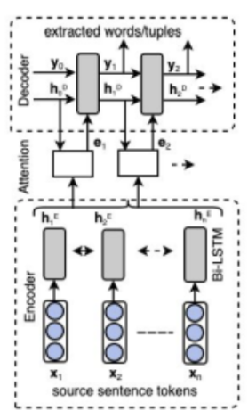
Architecture of an encoder-decoder model

Slide 15
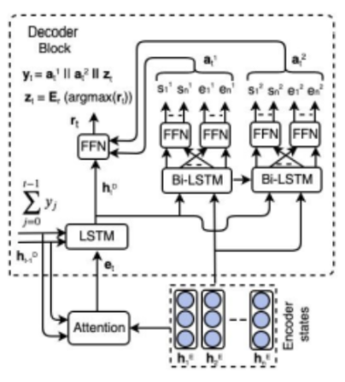
Pointer network-based decoder block

Slide 16
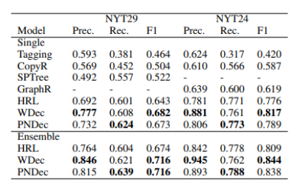
RESULTS
Performance comparison on the two datasets

Slide 17
CONCLUSION
Due to variable entity length, the inclusion of many tuples, and entity overlap across tuples, extracting related tuples from sentences is a difficult operation. In this research, we suggest two original strategies to tackle this task using the encoder-decoder architecture. New state-of-the-art F1 scores are greatly enhanced by our suggested models, according to experiments on the New York Times (NYT) corpus. We would like to investigate our suggested models for a document-level tuple extraction task as future work.

Slide 18
REFERENCES
https://link.springer.com/chapter/10.1007/978-3-030-57884-8_54
https://ojs.aaai.org/index.php/AAAI/article/view/6374/6230
https://aclanthology.org/2022.spnlp-1.2.pdf

